Slide 1
Permutation & Combination

Slide 2
Fundamental principles of Counting
Addition Rule
If a work can be performed in m different ways and a second independent work can be performed in n different ways, either of the two works can be performed in (m + n) different ways.
Multiplication Rule
If a work can be performed in m different ways and following which a second work can be performed in n different ways, then the two works in succession can be performed in m * n different ways.

Slide 3
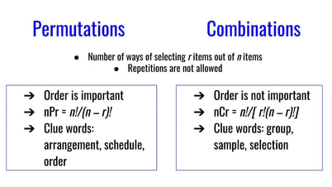

Slide 4
Permutation based problems:
Word Formation – with repetition, Without repetition
Number Formation – with / without repetition
Seating arrangement based questions
Combination based Problems:
Team Selection/ Committee Selection / Card Selection

Slide 5
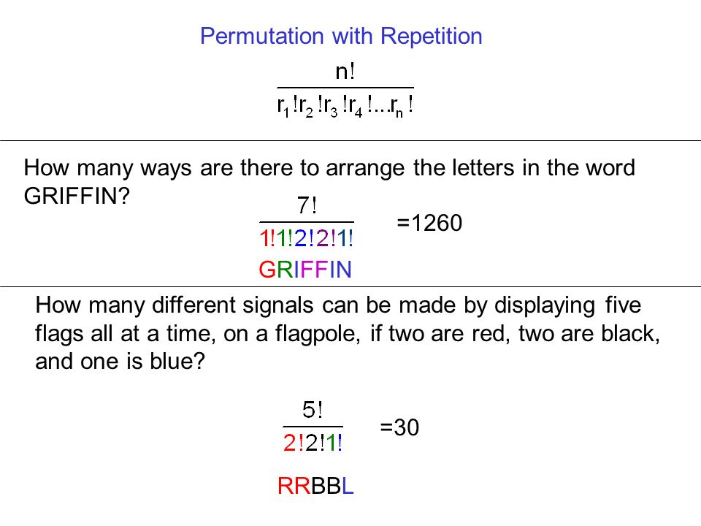

Slide 6
Permutation based problems:
Word Formation / Seating Arrangement –
Without repetition
Total ways
Always Together
Not together
Never Together
Specific Condition
“ORANGES”
Total ways - _ _ _ _ _ _ _ - 7 * 6 * 5 * 4 * 3 * 2 * 1 = 7!
Vowels Always together
(O A E) R N G S
= 5! * 3!
Vowels Not Together
= Total ways – Always Together
= 7! – (5! * 3!)
Vowels Never together
Place consonants first
R N G S
= 4! * 5P3
= 4! * 5*4*3

Slide 7
CIRCULAR PERMUTATION
A circular permutation is one in which objects are arranged along a circle. It is also called as closed permutation.The number of circular permutations of n distinct objects is (n –1)!, if the clockwise and anticlockwise directions are different.If there are n things and if the direction is not taken into consideration, the number of circular permutations is
(n 1)!/2.
There are 5 gentle men and 4 ladies to dine at a round table. In how many ways can they seat themselves so that no two ladies are together?
Solution
The number of ways in which 5 gentlemen may be arranged around a round table 4!= 24
Since no two ladies are to be together, the ladies can sit one between 2 gentle men, there are 5 places for ladies and they can use any 4 and this can be done in 5P4 = 120 ways.
The number of ways in which both the gentle men and the ladies arrange themselves 24 *120= 2880

Slide 8
How many numbers can be formed between 400 and 500 with the digits 0, 1, 2, 3 and 4? (If all it is digits have to be distinct).
Solution
Hundred place can be filled by 1 way (by filling 4).
Remaining 2 places can be filled by 4P2ways.
So,
required number = 1× 4P2= 12
If no two consonants are together then in how many wayscan the word RAINBOW be arranged?
C V C V C V C
3! * 4P4 = 6*24 = 144
How many 5-digit numbers can be formed by using the digits 1 to 9 if repetition of digits is not allowed?
Here, we need to find the number of permutations of 9 numerals taken 5 at a time. So, number of 5-digit numbers = 9P5
= 9 * 8 * 7 * 6 * 5
= 15120

Slide 9
A cultural committee of eight students is to be formed from 9 boys and 5 girls. In how many ways can it be done when the committee consists of (i) exactly 3 girls (ii) atleast 3 girls?
Solution
(i)We have to choose 3 girls out of 5 girls and 5 boys out of 9 boys.
No. of ways
5C3 * 9C5 = 1260 ways
(ii)The committee may take 3 or 4 or 5 girls
No. of ways of selecting 3 girls and 5 boys
5C3 * 9C5 = 1260
No. of ways of selecting 4 girls and 4 boys
5C4 * 9C4 = 630
No. of ways of selecting 5 girls and 3 boys
5C3 * 9C3 = 84
Required number of ways = 1260 +630 + 84 = 1974 ways

Slide 10
1. If I have kept six different books on a shelf, in how many different ways can I arrange them?
Solution:
Total ways = 6! = 720
2. In how many ways can the letters of the word "LEADER" be rearranged?
Solution:
Total ways = 6!/ 2!
= 720/2
= 360

Slide 11
3. In how many ways can the letters of the word "OPTICAL" be rearranged such that vowels are always together?
Solution:
(OIA) P T C L
= 5! * 3!
= 120 * 6
= 720

Slide 12
4. In how many ways can the letters of the word "SIGNATURE" be rearranged such
that vowels are never together?
Solution:
Place Consonants first
S G N T R – 5 Consonants
I A U E - 4 Vowels
S G N T R
= 5! * 6P4
= 120 * 6*5*4*3
= 120* 360
= 43200

Slide 13
5. In how many ways can the letters of the word "MACHINE" be arranged such that
vowels occupy only even positions?
Solution:
M C H N – 4 consonants
A I E – 3 vowels
C V C V C V C
= 3! * 4!
= 24 * 6
= 144

Slide 14
6. The number of 6-digit numbers that can be formed from 0, 1, 5, 6, 7 and 8 in which the first digit is not 0 are
Solution:
The first digit cannot be zero
= 5 * 5 * 4 * 3 * 2 * 1
= 600
5
5
4
3
2
1

Slide 15
7. The cause of productivity loss are to be written around a circle in the annual report. In how many ways can an analyst write them around the circle, if the number of causes are 5?
Solution:
In circular arrangement , total ways = (n-1)!
= (5-1)!
= 4!
= 24
8. . In how many ways can a group of 5 men and 2 women be selected from a group of
7 men and 5 women?
Solution:
Selection only so Combination based
= 7C5 * 5C2
= 7C2 * 5C2
= 7*6/2 * 5*4/2
= 21 * 10
=210

Slide 16
9. A box contains 2 white balls, 3 black balls and 4 red balls. In how many ways can
three balls be drawn from the box if at least one black ball has to be included in
the draw?
Solution:
Total balls = 2+3+4 = 9
Atleast one black ball so , total ways – no black ball
= 9C3 – 6C3
= 9*8*7/6 - 6*5*4/6
= 84 - 20
= 64

Slide 17
10. How many four digit numbers can be formed from the digits 2, 3, 5, 6, 7 and 9
which are divisible by 4 and none of the digits is repeated?
Solution:
= 4* 3
=12
= 4* 3
=12
4
3
3
2
4
3
9
2
= 4* 3
=12
= 4* 3
=12
4
3
3
6
4
3
9
6
= 4* 3
=12
4
3
5
2
= 12*8
=96
= 4* 3
=12
4
3
5
6
= 4* 3
=12
4
3
7
2
= 4* 3
=12
4
3
7
6

Slide 18
11. There are five types of envelopes and nine types of stamps in a post office. How
many ways are there to buy an envelope and a stamp?
Solution:
Multiplication rule
= 5 * 9
= 45

Slide 19
12. Find the number of ways in which the letters of the word ’EQUATION’ be written
such that no two consonants are together?
Solution:
Q T N– 3 consonants
A U O I E – 5 vowels
Place vowels first
A E I O U
= 5! * 6P3
= 120 * 6 * 5 * 4
= 120 * 120
= 14400

Slide 20
13. How many different ways can the letters of the word ’ENGINEERING’ be rearranged such that the vowels always come together?
Solution:
(EEE II)- 1 set
NNN GG R
= (7! * 5!)/ 3! * 3! * 2! * 2!
= 4200
14. There are 8 black balls and 8 white balls. In how many ways can these balls be arranged in a row so that balls of different colors are alternate?
Solution:
There are two possibilities
B W B W B W B W B W B W B W B W = 8! * 8!
= (8!)²
(OR)
W B W B W B W B W B W B W B W B =8! * 8!
= (8!)²
Therefore = (8!)² + (8!)²
= 2 *(8!)²

Slide 21
15. How many 4 digit numbers divisible by 5 can be formed with the digits 0, 1, 2, 3, 4, 5,6 and 6? (Repetition not allowed, which means 6 can be used 2 times other numbers can be used only once)
Solution:
Without using ‘atmost only one 6’
With atmost 2 6’s
Total
= 135 + 114
= 249
6
5
4
0
120
5
5
4
5
100
6
6
5
0
5
6
6
5
5
5
5
6
6
0
5
4
6
6
5
4
6
5
6
0
5
6
5
6
5
5
135
114

Slide 22
16. There are 20 people among whom 2 are sisters. Find the number of ways in which we can arrange them around a circle so that there is exactly one person between the 2 sisters.
Solution:
Let the two sisters be S1, S2
Others persons be A, B, C, D , ……., P, Q , R
(S1, _ , S2) - 1 set
= 17! * 18 * 2!
= 18! * 2!
circular arrangement = (n-1)!

Slide 23
17 . If you jumble and arrange the word LABOUR in all possible ways and arrange
all the words so formed as in a dictionary. What will be the rank of the word
LABOUR?
Solution:
LABOUR
First arrange the word in alphabetical order
ABLORU
A _ _ _ _ _ = 5! = 120
B _ _ _ _ _ = 5! = 120
L A B O R _ = 1! = 1
L A B O U R = 0! = 1
So the Rank of the LABOUR = 120+120+1+1 = 242

Slide 24
18. A student selects 3 digits from numbers 1 to 9 such that they are in strictly increasing order. How many selections have the property that the three digits form an arithmetic progression?
Solution:
With common difference 1
1,2,3 2,3,4 3,4,5 4,5,6 5,6,7 6,7,8 7,8,9
Total = 7
With common difference 2
1,3,5 3,5,7 5,7,9 2,4,6 4,6,8
Total = 5
With common difference 3
1,4,7 2,5,8 3,6,9
Total = 3
With common difference 4
1,5,9
Total =1
So , 7+5+3+1 = 16

Slide 25
19. How many numbers can be made with digits 0, 7, 8 which are greater than 0 and less than a million?
Solution:
3* 3 * 3 * 3 * 3 * 3 = 729
Neglect one case where we get 0 0 0 0 0 0 ,
So 729 – 1 = 728
3
3
3
3
3
3

Slide 26
DISTRIBUTION BASED PROBLEMS – PARTIONING BASED
‘N’ IDENTICAL ITEMS IN ‘R’ DISTINCT GROUPS
Example : Distribution ‘n’ chocolates to ‘r’ different persons
Two different cases:
No restriction for 0 or empty .
With Restriction where no box can be empty
Case 1:
^{N+r-1} C _{r-1}
Case 2:
^{N-1} C _{r-1}

Slide 27
DISTRIBUTION BASED PROBLEMS – PARTIONING BASED
‘N’ distinct objects IN ‘R’ identical GROUPS
Example : Distribution ‘n’ chocolates to ‘r’ different persons
Two different cases:
No restriction = R^{n}
With Restriction then arrangement will play a major role

Slide 28






Derangement based problems
Derangement :
If ‘n’ things form an arrangement in a row, the number of ways in which they can be arranged so that none of them occupies its original place.
Example:
Surya
Mahesh babu
Vijay
Ajith
Pawan kalyan
Allu Arjun

Slide 29

Derangement Formula
Total ways:
Derangement(D) = n! $(1−\frac{1}{1!}+\frac{1}{2!}−\frac{1}{3!}+\frac{1}{4!}−\frac{1}{5!}+\frac{1}{6!}+…………..\left(−1\right)n\frac{1}{n!} )$

Slide 30
20. In how many ways can 5 apples (identical) be distributed among 4 children? (Some
children may get no apples.)
Solution:
+ + +
n+r-1
C
r-1
Here n = 5, r = 4
5 + 4 -1
C
4-1
= 8C3
= 8*7*6 / 6
= 56
A
B
C
D

Slide 31
21. The number of non-negative integral solutions of the equation a + b + c + d = 20 will be
Solution:
+ + +
n+r-1
C
r-1
Here n = 20, r = 4
20 + 4 -1
C
4-1
= 23C3
= 23*22*21 / 6
= 23*77
= 1771
A
B
C
D

Slide 32
22. How many ways can a group of 4 men and 3 women be selected from a group containing 7 men and 6 women so that Ms .X refuses to be in the same group as Mr. Y?
Solution:
Case 1: Ms.X is selected , then Mr.Y cannot be selected
= 6C4 * 5C2
= 6C2 * 5C2
= 6*5/2 *5*4/2
= 15*10 = 150
Case 2: Mr.Y is Selected , then Ms.X cannot be selected
= 6C3* 5C3
= 6*5*4/6 * 5*4/2
= 20*10 = 200
Case 3: Both Mr.Y and Ms.X not getting selected
= 6C4 * 5C3
= 15*10 = 150
Total ways = 150+150+200
= 500

Slide 33
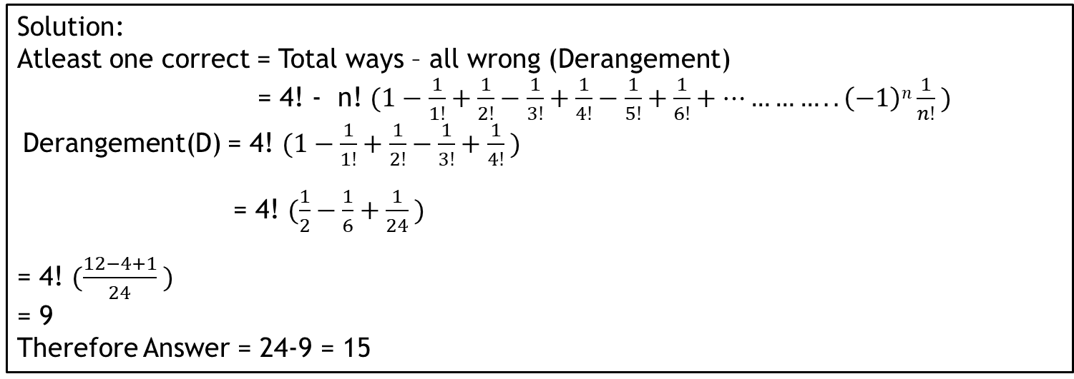
23. There are 4 different letters and 4 addressed envelopes. In how many ways can the letters be put in the envelopes so that at least one letter goes to the correct address?
Solution:
Atleast one correct = Total ways – all wrong (Derangement)
= 4! - n! $(1−\frac{1}{1!}+\frac{1}{2!}−\frac{1}{3!}+\frac{1}{4!}−\frac{1}{5!}+\frac{1}{6!}+…………..\left(−1\right)n\frac{1}{n!} )$
Derangement(D) = 4! $(1−\frac{1}{1!}+\frac{1}{2!}−\frac{1}{3!}+\frac{1}{4!} )$
= 4! $(\frac{1}{2}−\frac{1}{6}+\frac{1}{24} )$
= 4! $(\frac{12−4+1}{24} )$
= 9
Therefore Answer = 24-9 = 15

Slide 34
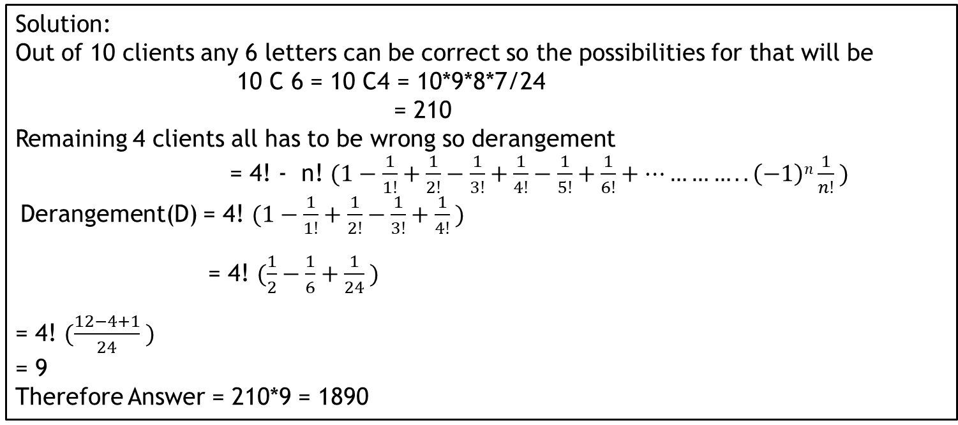
24. A manager has to send 10 letters to 10 clients. She writes the 10 envelopes and
addresses the 10 envelopes and then calls in her secretary and asked her to put the letters in the envelopes and mail them. In how many ways can the manager send the letter such that she gets exactly 6 letters correct?
Solution:
Out of 10 clients any 6 letters can be correct so the possibilities for that will be
10 C 6 = 10 C4 = 10*9*8*7/24
= 210
Remaining 4 clients all has to be wrong so derangement
= 4! - n! $(1−\frac{1}{1!}+\frac{1}{2!}−\frac{1}{3!}+\frac{1}{4!}−\frac{1}{5!}+\frac{1}{6!}+…………..\left(−1\right)n\frac{1}{n!} )$
Derangement(D) = 4! $(1−\frac{1}{1!}+\frac{1}{2!}−\frac{1}{3!}+\frac{1}{4!} )$
= 4! $(\frac{1}{2}−\frac{1}{6}+\frac{1}{24} )$
= 4! $(\frac{12−4+1}{24} )$
= 9
Therefore Answer = 210*9 = 1890

Slide 35
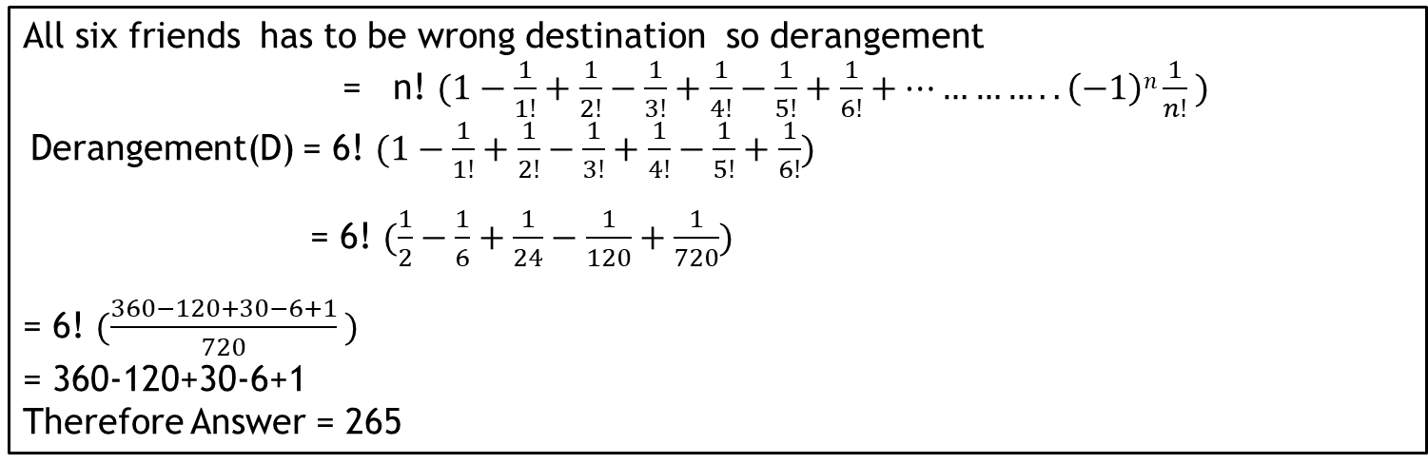
25. There are six friends who take 6 different buses which go in six different routes from a particular junction. Given that, one person can board only one bus at a time. How many combinations are possible such that none of the six friends reaches the correct destination?
All six friends has to be wrong destination so derangement
= n! $(1−\frac{1}{1!}+\frac{1}{2!}−\frac{1}{3!}+\frac{1}{4!}−\frac{1}{5!}+\frac{1}{6!}+…………..\left(−1\right)n\frac{1}{n!} )$
Derangement(D) = 6! $(1−\frac{1}{1!}+\frac{1}{2!}−\frac{1}{3!}+\frac{1}{4!}−\frac{1}{5!}+\frac{1}{6!})$
= 6! $(\frac{1}{2}−\frac{1}{6}+\frac{1}{24}−\frac{1}{120}+\frac{1}{720})$
= 6! $(\frac{360−120+30−6+1}{720} )$
= 360-120+30-6+1
Therefore Answer = 265

Slide 36

26. In how many ways is it possible to choose a white square and a black square on a chessboard so that the squares must not lie in the same row or column?
To Select white square 32 C 1 = 32
To select Black square 24 C 1 = 24
32 C 1 * 24 C 1 = 32*24
= 768

Slide 37
27. How many natural numbers less than 4300 can be formed with the digits 0, 1, 2, 3, 4 (if repetitions are not allowed)?
Solution:
Single digit number
Two digit number
Three digit number
Four digit number
Total
= 4+16+48+24+24+24+18
= 158
4
4
4
4
16
4
4
3
48
1
4
3
2
24
2
4
3
24
3
4
3
2
24
2
4
3
3
2
18

Slide 38
28. In how many ways can you pack 5 different gifts in 3 identical boxes such that no box is empty, if any of the boxes may hold all of the gifts??
Solution:
(5C3 * 2C1 * 1C1)/ 2!
= (5*4/2 * 2 * 1)/2
=10
or
= (5C2 * 3C2 * 1C1)/2
= (10*3*1)/2
= 15
Total = 10+15
= 25
3
1
1
2
2
1

Slide 39
29. A polygon has 54 diagonals. Find the number of sides.
To form a diagonal we need to select two points out of n points and subtract with the number of sides
NC2 – N = 54
N (N-1) / 2 = 54 + N
N = 12

Slide 40
30. In how many ways can the letters of the word EDUCATION be rearranged so that the relative position of the vowels and consonants remain the same as in the word EDUCATION?
Solution:
D C T N – 4 consonants
A U I O E – 5 vowels
E D U C A T I O N
= 5! * 4!
= 120*24
= 2880

Slide 41
31. In how many ways can the letters of the English alphabet be arranged so that there are 7 letters between the letters A and B?
Solution:
A B C D E F G H I J ………………. X Y Z
(A, _ , _, _, _, _, _, _, B) - 1 set
= 2! * 24 p 7 * 18!

Slide 42

32. At a business meeting, every person shakes each other’s hands once. How
many people were present for the meeting if there was a total of 91 handshakes?
Solution:
N C 2 = 91
N (N-1)/2 = 91
N(n-1) = 182
N = 14

Slide 43
33. The number of permutations of the letters a, b, c, d, e, f, g such that neither the pattern ’beg’ nor ’acd’ occurs is
Solution:
CASE 1: ACD TOGETHER
(ACD) B E F G
TOTAL WAYS = 5!
CASE 2: BEG TOGETHER
(BEG) A C D F
TOTAL WAYS = 5!
REMOVING DUPLICATION (ACD ) & (BEG) TOGETHER
(ACD) (BEG) F
= 3! =6
SO 120+120-6 = 234
SINCE WE DON’T WANT THIS CASE WE SUBTRACT FROM TOTAL WAYS
TOTAL WAYS = 7!
ANSWER = 5040-234
= 4806

Slide 44
34. How many teams of 4 persons can be formed out of 7 men, 3 women and 5 boys
if each team has a man and contains at least one woman?
Solution:
CASE 1: 1 MAN & 1wOMEN & 2 bOYS
7C1 * 3C1 * 5C2 = 7*3*10
TOTAL WAYS = 210
CASE 2: 1 MAN & 2 wOMEN & 1 Boy
7C1 * 3C2 * 5C1 = 7*3*5
TOTAL WAYS = 105
CASE 3: 1 MAN & 3 wOMEN
= 7C1 * 3C3
= 7*1
=7
SO 210+105+7 = 322

Slide 45
35. The number of ways which a mixed double tennis game can be arranged amongst 9 married couples if no husband and wife play in the same is
Solution:
A
a
b
To select male = 9C2
To select female = 7C2
One of the possible combination
AB ef
So teams can be
Ae & Bf [or] Af & Be – 2 possibilities
So answer = 9C2 * 7C2 * 2!
= 9*8/2 * 7*6/2 * 2
= 36 * 21 * 2
= 72* 21
= 1512
B
C
c
D
d
E
e
F
f
G
g
H
h
I
i

Slide 46
36. How many numbers can be formed from 1, 2, 3, 4, 5 (without repetition), when the digit at the unit’s place must be greater than that in the ten’s place?
Solution:
In permutation every number will be equally distributed so we can say out of the total ways half the number of times unit digit will be greater than tens digit & other ways unit digit will be lesser than the tens digit.
Answer = n! / 2 = 120/2 = 60
Example 1234
1234 1243 1324 1342 1423 1432
2134 2143 2314 2341 2413 2431
3124 3142 3214 3241 3412 3421
4123 4132 4213 4231 4312 4321

Slide 47
37. Some boys are standing on a circle at distinct points. Each possible pair of persons, who are not adjacent, sing a 3 minute song, one pair after another. The total time taken by all the pairs to sing is 1 hour. Find the number of boys?
Solution:
1 HOUR = 60 MINUTES
3 MINUTES SONG SO 20 PAIRS WOULD HAVE SUNG THE SONG
N (N-3)/ 2 = 20
N (N-3) = 40
8*5 =40
circular arrangement = (n-1)!
N = 8

Slide 48
38. In an examination, a question paper consists of 12 questions divided into two parts (i.e) Part I and Part II containing 5 and 7 questions respectively. A student is required to attempt 8 question in all selecting at least 3 from each part. In how many ways can a student select the questions?
Solution:
Total 12 Questions
Part 1(5) & part 2(7)
3 & 5 = 5C3 * 7C5 = 10*21 = 210
4 & 4 = 5C4 * 7C4 = 5*35 = 175
5 & 3 = 5C5 * 7C3 = 35
TotAL = 210+ 175 + 35
= 420

Slide 49
39. Ten points are marked on a straight line and 11 points are marked on another
straight line. How many triangles can be constructed with vertices from among the
above points?
Solution:
. . . . . . . . . .
. . . . . . . . . . .
= 10C2 * 11C1 + 11C2*10C1
= 45*11 + 55*10
= 495 + 550
= 1045

Slide 50
40. An intelligence agency forms a code of two distinct digits selected from 0, 1, 2, .....,9 such that the first digit of the code is nonzero. The code, handwritten on a slip, can however potentially create confusion, when read upside down-for example, the code 91 may appear as 16. How many codes are there for which no such confusion can arise?
Solution:
Total two digit numbers possible = 9 * 9 = 81
Confusing numbers when turning upside down
0,1,6,8,9
Two digit numbers that can be formed by using the above numbers are
= 4*4 =16
Out of that 16
10,60,80,90,69,96 will not create confusion so we can remove those numbers
= 16-6 =10
answer = 81-10
= 71

Slide 51
41. In the figure given below, the lines represent one way road allowing travel from any point, only to up or to the left. Along how many distinct routes can a vehicle reach a point B from Point A?
Solution:
LLLLLUUU---- = 8!/ (5! * 3!)
= 56

Slide 52
42. An ant starts moving on the mesh shown below along the wires towards a food particle . If the ant is at the bottom-left corner of cell A and the food is at the top-right corner of cell F, then find the number of optimal routes for the ant.
Solution:
(UUUUUUUUUUUUURRR)(RRRRRUUUUUUUUUUUU)
= (16!/(13!*3!))*(17!/(12!*5!))
= 3465280.

Slide 53
43. There are 100 articles numbered n1, n2, n3, n4, ...., n100. They are arranged
in all possible ways. How many arrangements would be there in which n28 will always be before n29.
Solution:
N1,n2,n3,n4,………..,n100
Total ways = 100!
N28 always before n29 = 100!/2
= (100 * 99!)/2
= 50* 99!
= 50*99 * 98!
= 4950*98!

Slide 54
44. A five-digit number is formed using digits 1, 3, 5, 7 and 9 without repeating any one of them. What is the sum of all such possible numbers?
Solution:
1 3 5 7 9
…………………………………………………
……………………………………………………
…………………………………………………..
………………………………………………………
…………………………………………………………
unit digit = 9*24+7*24+5*24+3*24+1*24
= 24(9+7+5+3+1)
= 24*25 = 600 = 0 (60 carry over)
Tens digit = 660 = 0 (66 carry over)
Hundred digit = 600+66 = 666 = 6 (66 carry over)
Thousand’s digit = 600+66 = 666 = 6 (66 carry over)
Ten thousands digit = 600+66 = 666
So sum = 6666600

Slide 55
45. A party of ’n’ persons sits around a table. Find the odds against two specified persons sitting next to each other.
Solution:
Total no.of.ways in which ‘n’ persons be sitting around circular table – (n-1)!
Total no.of .ways in which specific two persons are sitting next to each other
= (n-2)!*2!
Total no.of.ways in which two specific persons are not sitting next to each other
= (n-1)! – 2(n-2)!
= (n-1)(n-2)! – 2(n-2)!
= (n-2)!(n-1-2)
= (n-2)! (n-3)
Odds not sitting together to always sitting together
= (n-2)!(n-3): (n-2)!*2!
= (n-3) : 2

Slide 56
46. In how many possible ways can we write 3240 as a product of 3 positive integers a,b and c?
Solution:
Prime factorization of 3240 = 2³ * 3⁴ * 5¹
a,b, c be the three positive integers
A= 2^{x1} * 3^{y1} * 5^{z1}
B= 2^{x2} * 3^{y2} * 5^{z2}
C= 2^{x3} * 3^{y3} * 5^{z3}
X1+x2+x3 = 3 => total ways n+r-1 C r-1 = 5C2 = 10
Y1+ y2 + y3 = 4 => total ways n+r-1 C r-1 = 6C2 = 15
Z1+ Z2 + Z3 = 1 => total ways n+r-1 C r-1 = 3C2 = 3
Total ways = 10*15*3 = 450

Slide 57
47. In how many possible ways can you write 1800 as a product of 3 positive integers a, b and c?
Solution:
Prime factorization of 1800 = 2³ * 3² * 5²
a,b, c be the three positive integers
A= 2^{x1} * 3^{y1} * 5^{z1}
B= 2^{x2} * 3^{y2} * 5^{z2}
C= 2^{x3} * 3^{y3} * 5^{z3}
X1+x2+x3 = 3 => total ways n+r-1 C r-1 = 5C2 = 10
Y1+ y2 + y3 = 2 => total ways n+r-1 C r-1 = 4C2 = 6
Z1+ Z2 + Z3 = 2 => total ways n+r-1 C r-1 = 4C2 = 6
Total ways = 10*6*6 = 360

Slide 58
48. In how many ways you can select two letters from the English alphabets such that none of the alphabets is a consecutive consonant.
Solution:
Total ways – selecting consecutive consonant
26C2 – 16
(26*25/2) – 16
325 – 16
309

Slide 59
49. The letters in the word ADOPTS are permuted in all possible ways and arranged in the alphabetical order. Find the word at position 42 in the permuted alphabetical order.
Solution:
A D _ _ _ _ = 24
A O D _ _ _ = 6
A O P _ _ _ = 6
A O S _ _ _ = 6 [sum 42]
So 42 nd word will be A O S T P D

Slide 60
50. A 3 * 3 grid is colored using red and blue colors such that if we rotate the grid about its center in the plane by 180 degrees, the grid looks the same. The number of ways to color this grid is
Solution:
1=9,2=8,3=7,4=6,5 each can have 2 different colors
Total ways = 2^5 = 32 ways
5
5
1
2
3
9
8
7
4
6
4
6
7
8
9
1
3
2

